Slide 1
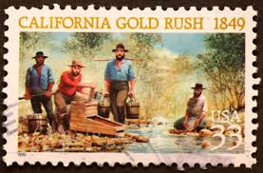
To Destroy in whole or in part:
Remembering the Past to Affirm Our Future

Slide 2
To Destroy in Whole of in Part
© 2014 Jack Norton, Executive Director,
Center for the Affirmation of Responsible Education
654 Golden Lane, Medford, OR 97504
All rights reserved. No part of this work, including text and photos may be reproduced, photocopied or transmitted in any form without the written permission of the author.
PowerPoint based on the title essay in the book If the Truth Be Told: Lessons of Innocence Denied: Cases in California Genocide, 1852-1887. Edited and with an Introduction by Jack Norton, author of Genocide in Northwestern California: When Our Worlds Cried.

Slide 3
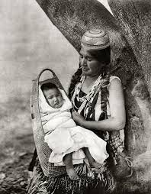
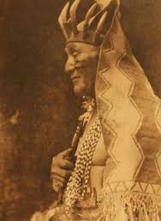
It is a time of renewal, to be amongst the energy of creation, to be re-recreated, born anew, and cleansed of a year’s accumulation of stress, anxieties, and distorted information, negative thoughts, or projections onto others for what we have failed to become. For ten days my wife and I stand within the radiance of ancestral memory as we visit, eat, and enjoy the company of those we have missed throughout the year.

Slide 4
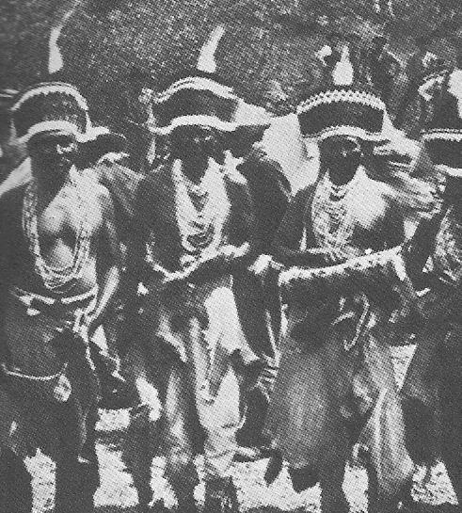
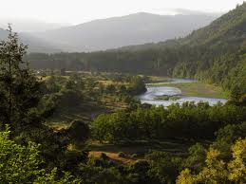
Part I: At the Center of Our Being . . .
Each summer I return to northern California, to the land of the Hupa, Yurok, and Karuk. I return to pray and dance within the centers of our world.

Slide 5
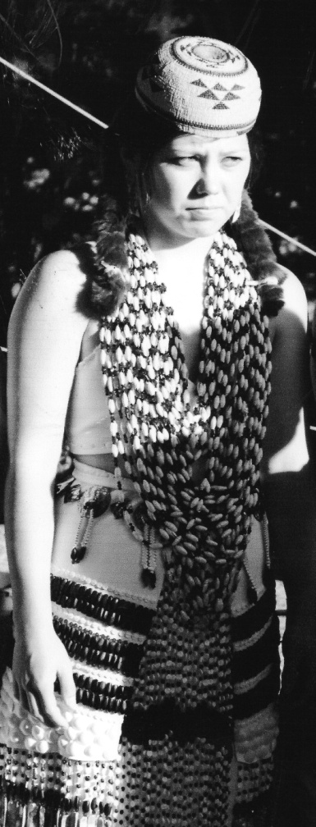
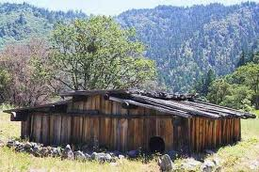
I join my cousins, my sons, my grandchildren, nephews and friends, to sing and dance once again upon the grounds cleansed and purified by spiritual energy eons ago.
Takimildin—center of the world for the Hupa
Kira Norton, my granddaughter

Slide 6
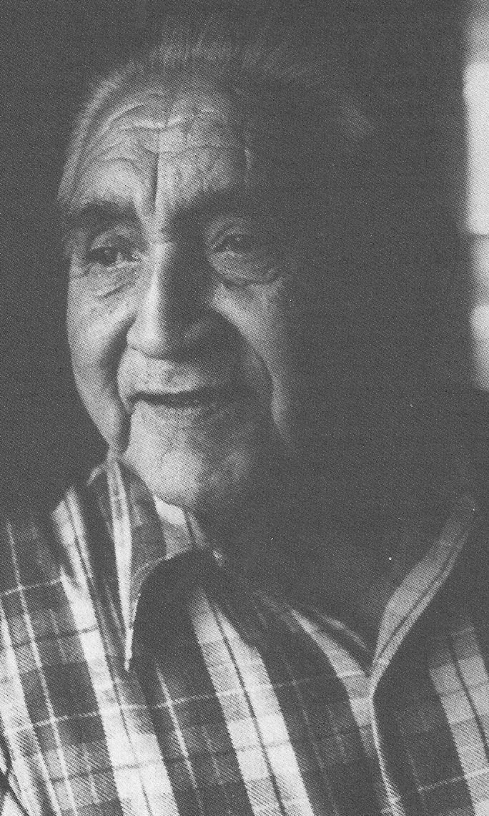
Yet, within this aura of renewal, I feel a tinge of sadness and concern—for how many of our youth and even some adults know the true meaning and purpose, as well as essence of these prayers in motion? How many understand the teachings of the spiritual leaders and dance makers? Or better yet, instill these teachings into their daily lives?
Rudolph Socktish, Spiritual Leader

Slide 7
How much has been lost? How much was taken or beaten from them? Were they there when others from a different faith stood in front of the dancers and shouted at the people to stop this paganism? Or they were told that if they did not go home the superintendent would arrest them?
Many of the men and women my age had parents that were sent away to Indian boarding schools. My father was sent to Phoenix Indian Industrial Boarding School in 1912, and then to Haskell Institute in Lawrence, Kansas. He did not return home until 1942.

Slide 8
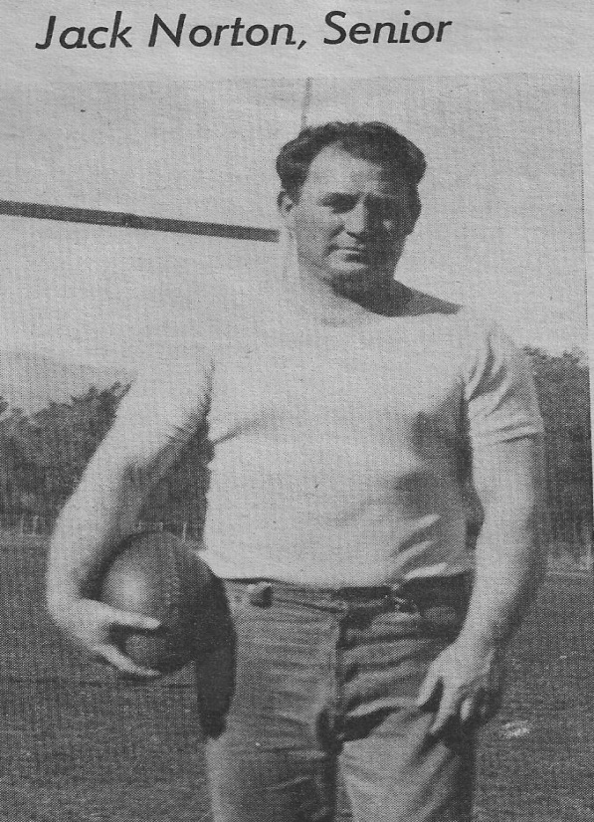
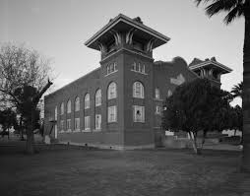
His father, my grandfather, Sherman Norton, was threatened by the superintendent with forced removal from the reservation for writing numerous letters to the BIA complaining about the unfair treatment and unequal wages paid to Indian employees.
Phoenix Indian Boarding School. According to Robert A. Tennert, its “purpose was to remove Indian children from their traditional environments, to obliterate their cultural heritage, and replace
that . . .with the values of white middle class America” (p. xi).

Slide 9
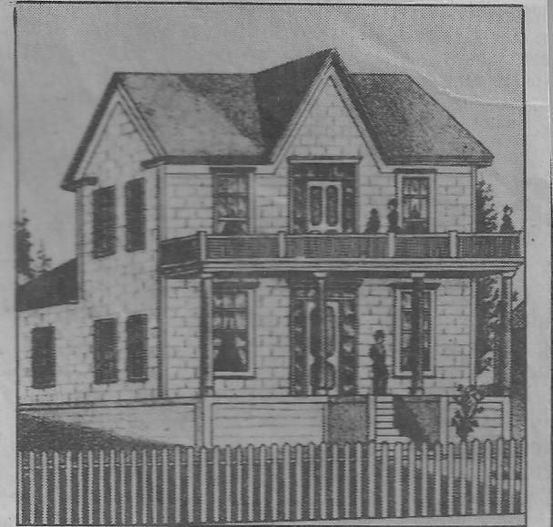
His father, my great-grand father, Amonzo Norton, came to California in the early 1850’s and married a full blood Hupa woman from the Quimby family from the village of Tswenaldin. During this pivotal time, all around them Indian villages, families, men, women and children were being attacked and killed. Many were sold into slavery, especially young pretty girls—often for $250 to a lonely gold miner or farmer.
House where my great grandfather Amonzo Norton homesteaded in present day Blue Lake.

Slide 10
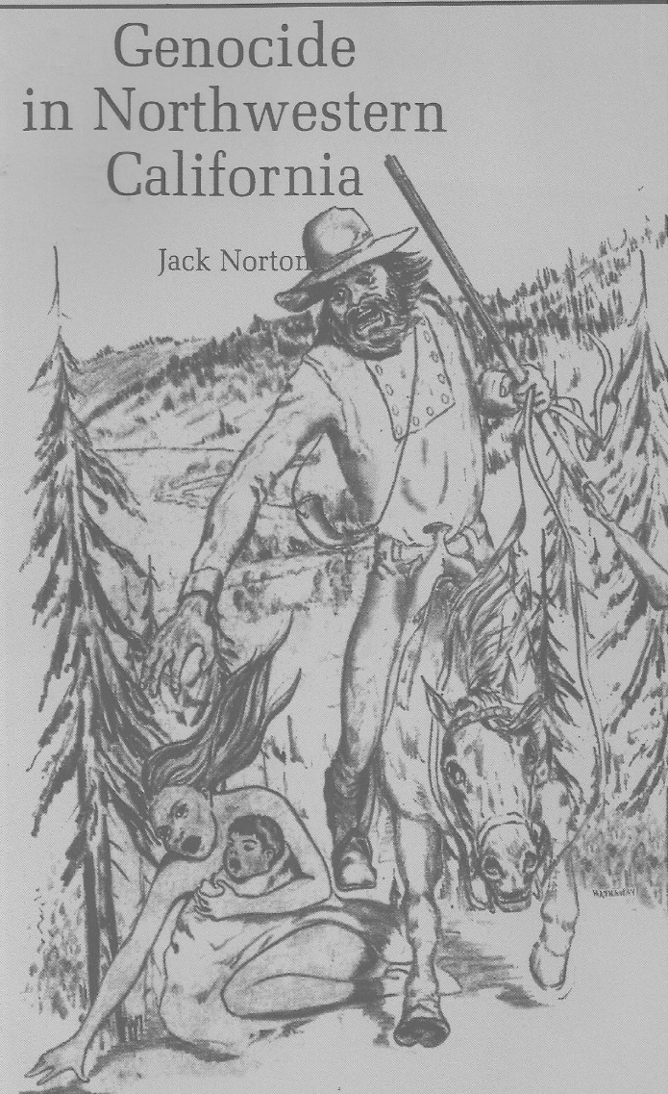
In Shasta City, 100 miles east of Hoopa, an Indian head was worth $5.00 or a scalp for $1.50 to be paid at the local court house. All around Hoopa, the newspapers at Eureka, Yreka, Shasta, and Redding called for the extermination of the native peoples. To most miners and settlers, Indians were no more than heathens, savages, or life unworthy of life.
The official sanction to commit genocide or the intent to destroy native cultures and life ways was declared by Governor Bigler in January of 1851. His charge to exterminate whipped the pathological fear and projection of many miners and settlers to commit some of the most heinous crimes against humanity then or since.

Slide 11
With hate filled eyes, and wicked intent men shot, knifed and maimed. Some, picked up babies by the heels and smashed their heads against rocks, or as a Tolowa man related, many years later, and yet with tears in his eyes that, “at Yontoket babies were impaled on sticks and roasted by the fire, their little fingers moving.” Elsewhere, I have tried to tell some of the stories of human suffering. I have tried to feel into the experience of what it was like to be at Yontoket or at the Bridge Gulch Massacre in 1852.
Site of Yontoket Massacre, 1853

Slide 12
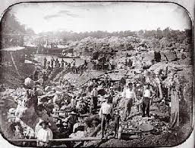
Part II: History as Lived . . .
There were at least 250,000 miners and settlers in California by 1852. There were 2000 on the Trinity River by Big Bar and nearby Weaverville and at Hayfork. In the summer of 1850, miners, for example, had diverted the entire river at Junction City because they thought that gold could be found at the bottom.

Slide 13
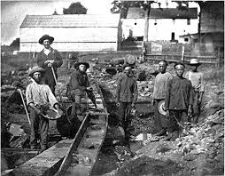
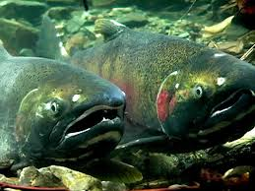
Salmon, a blessed food source for native northwestern cultures were severely depleted and their natural habitats destroyed.

Slide 14
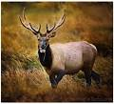
Salmon runs were disrupted, hogs and cattle destroyed acorns and grasses that were essential to the general food supply such as deer, elk and other game the natives relied on for sustenance.
Indians could be shot without repercussion. Many native peoples, faced with starvation, harassment, fear and anxiety fled to the hills or mountains to hide, still others attacked settler livestock to feed their families. A group of Wintun Indians took five cattle belonging to a Colonel Anderson. In the foray, Anderson was killed.

Slide 15
Hayfork or Bridge Gulch Massacre
By the time Anderson’s body reached Weaverville, a posse of 75 male volunteers had been organized. Merchants and others furnished weapons and supplies. Under the leadership of the local sheriff they set upon the track. A camp of Wintuns was located in the evening near present day Natural Bridge.
Site of the Bridge Gulch Massacre, 1852

Slide 16
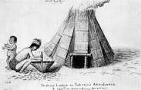
That night, as the unsuspecting families lay down to sleep, they were ringed by desperate men lying in cover with rifles cradled in their arms. At day break the signal was given. One hundred and fifty three men, women and children were slaughtered without provocation. They were given no chance, but paid with their lives for five cattle and for the death of one man, who had perhaps unknowingly intruded into Wintun aboriginal homelands, the natural and secure world of their ancestors. No burial followed. Their bodies were left to rot and their bones lay scattered and bleaching under the sun to be later found by loved ones or scavenged by animals.

Slide 17
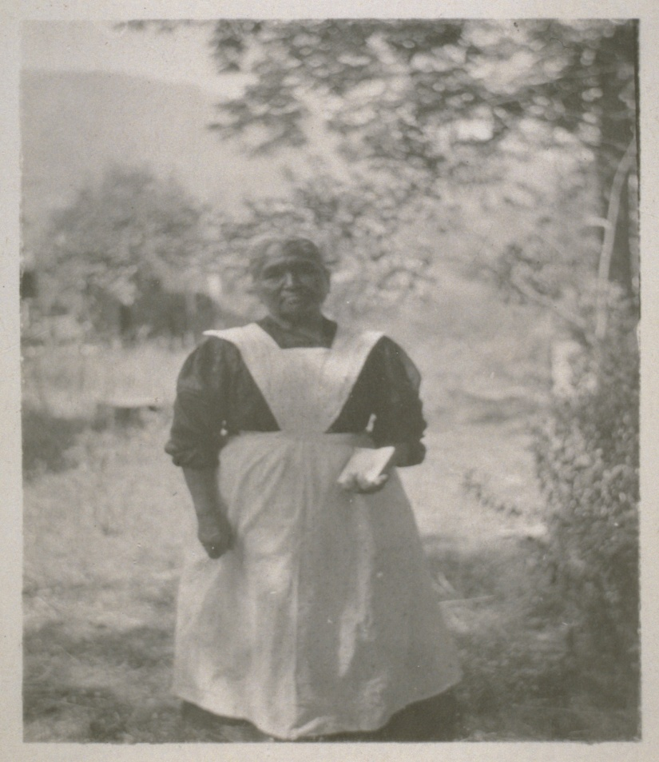
Two or three infants were carried back to Weaverville and sold into slavery or were adopted into white servitude. One such infant, a Ellen Clifford became a nanny for the Meckels, a local family. She died at the age of 77 and is buried in the Weaverville Catholic cemetery.
Ellen Clifford, survivor of the Bridge Gulch Massacre

Slide 18
Later, the Wintun account of the massacre was recorded by Grace Nolton McKibben, who was perhaps the last full blooded Wintun in the Hayfork area.
McKibben states that her uncle, Bob Tewis, also a survivor of the massacre, told her that those “young warriors who were guilty of the murder of Col. Anderson passed by the Bridge Gulch fleeing on up Hayfork Creek in the night. The large band of Wintun camped in the gulch were mainly women and children, and were unaware of danger as the men were away hunting.” Apparently, the raiders who stole the cattle and killed Anderson escaped punishment.

Slide 19
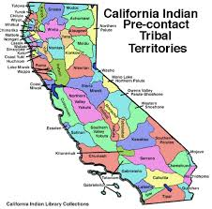
TheYontoket and Hayfork massacres are only two of the hundreds of massacres that occurred through out California. At least, 93% over-all of California Indians died during and after the Gold Rush era. Entire Indian nations were destroyed. For example, where are the Chimariko? Gone. Where are the Yuki? Gone. Where are the Mattole and Sinkyone? Gone. There may be individuals of these ancestories but these national, ethnical, racial or religious groups were intentionally decimated in whole or in part by all or some of the means as established by the Geneva Convention on Genocide, Article II:
Killing members of the group;
Causing serious bodily or mental harm to members of the group;
Deliberately inflicting on the group the conditions of life calculated to bring about its physical destruction in whole or in part;
Imposing measures intended to prevent births within the group;
Forcefully transferring children of the group to another group.

Slide 20
Part III: The Charge of Genocide . . .
No two genocidal events are the same. They will vary as to the intent of the perpetrators, the geography, the political situations and history. For example, in central California, the tribal nations on and near what was to become Sacramento were devastated by malaria in the 1830s that was introduced by trappers and traders from Vancouver and Canada. Also, they had been periodically raided by the Spanish to capture more souls to be saved at the missions in the San Francisco Bay area.
Therefore, when news of gold found at Coloma leaked out, greed soon turned into a pathology. The term pathology in this case refers to a pronounced deviation from assumed and socially acceptable behaviors and values to the degree that healthy functioning is no longer possible. Men left wives and families, abandoned professions and raced to the mines and river beds of California in a largely misguided frenzy to chase and capture, at all cost, an allusive chance at fame and fortune.

Slide 21
The majority of settlers were Christians who accepted the teachings of Christ, and the ideals that all men “are created equal.” Yet, some committed some of the most terrible acts of inhumanity in American history.
When the 18 treaties with California Indians were not ratified in July of 1852, no reservations were established in the north until 1855. For three long years, settlers raped, killed, enslaved, brutalized, and maimed native people, and stole their land without any repercussions. In fact, they were encouraged to exterminate all Indian people by politicians, community leaders, elected officials, and newspapers.

Slide 22
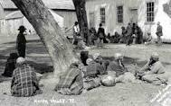
When the Indian people acted to protect their families and their homes, more paranoia and projected calls for their extermination went out from the white perpetrators. Federal troops were sent to Eureka to construct Fort Humboldt in 1853 and Fort Gaston at Hoopa in 1858.
For the Hoopa, this opened up a new phase of occupation from being over run by settlers, to soldiers who began to directly interfere in the life of the villages. The soldiers raided and stole items and spread diseases such as syphilis and gonorrhea by raping the women. Orders were issued that no guns could be carried by Indians and no one could cross arbitrary boundaries or they would be shot on sight. When these professional soldiers were sent to the east coast to fight in the Civil War in 1861, Fort Gaston was manned by three companies of California volunteers.

Slide 23
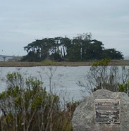
These volunteers were the very men who held varying degrees of hatred and ambition in California. One such individual, a Hank Larrabee and ten of his volunteers known as the Hydesville Dragoons, planned and orchestrated the notorious Indian Island Massacre in February of 1860, and arrived at Fort Gaston in September of 1861. In response, many Hupa people fled to the mountains and several Indian leaders such as Big Jim of Matildin, Tswenaldin John, and Handsome Billy led Indian warriors against the soldiers for several years. It was said that Big Jim could call out 200 warriors when needed.
Site of the Indian Island Massacre, 1860

Slide 24
Over the next three years, numerous attacks on both sides occurred, but by January of 1864, 600 soldiers were at Fort Gaston and by February they had burned down the village of Tswenaldin, and had moved the village of Matildin next to the fort.
In April 1864, Congress authorized four reservations in California under a single superintendent, and on August 12, 1864, a Treaty of Peace and Friendship obligated the federal government to render services and protection in return for a general peace and end of the conflict.
The Hupa leaders signed in good faith but in an act of governmental deceit, the then acting Commissioner of the Bureau of Indian Affairs, Dole reminded his peers that “it was not the policy of the United States to enter into formal treaties with California Indians” (Anderson, “Hoopa Valley,” p. 119).

Slide 25
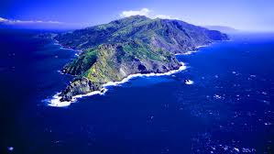
Then, in 1870, missionaries arrived under President Grant’s new policy to bring honesty and equity to the reservations in America. Hoopa fell to the Methodist-Episcopal church and for the next seven years, graft, corruption, and favoritism was granted, particularly to white trespassers who wanted to grow crops, sell goods, or move onto the reservation. If the Hupa people complained they were threatened to be sent to Round Valley Reservation, to a southern California mission or even removal to the traditional homelands of the Tongva Nation and to Santa Catalina Island.

Slide 26
Part IV: The Wave of Assimilation . . .
After years of blatant disregard for the separation of church and state, forced assimilation and Christianity, which had threatened the Hupa, the valley was once again subjected to military rule under the charge of Captain Richard Parker as of May 1877. Many were convinced that the “savage” Indian needed to be tamed and taught the virtues of Victorian domestic values and behaviors as well as the primacy of individualized property and profit.
1887 passage of the Dawes Act—Hoopa Reservation was surveyed and individual allotments were made. The Hupa insisted that only the valley floor and low grasslands would be assigned thus protecting the ceremonial and dance grounds, along with mountain timberlands which were to be held by the tribe in common.
1892 all soldiers left the valley. The BIA soon occupied the buildings of Fort Gaston to expand the boarding school where an aggressive policy to destroy the customs and culture, religion and language as well as the tribal identity of the Hupa was enacted.

Slide 27
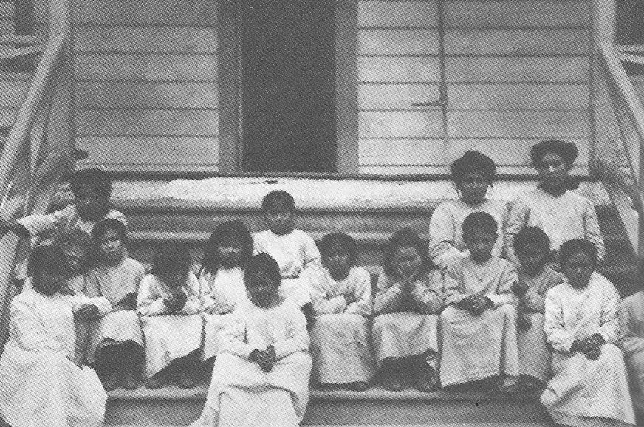
and Forced Termination
Young Indian girls in Hoopa subjected to the will and ways of the dominant white culture.
1957 to 1959 Hupa was faced with the termination policy enacted by the federal government under the Rancheria Act, implemented by Congress in 1958. This termination act, called for ending any and all relationships, moral obligations, and trust responsibilities between California Indian Nations and the federal government.
My father as tribal chairman, and the tribal council that was formed in 1950, successfully fought off all efforts to terminate the Hupa Reservation. However, forty one tribal nations in California were terminated. These policies were reversed under the Tellie Hardwick Act of 1983, which allowed terminated tribes to seek the long process of federal recognition. Some California Indian nations such as the Ohlone and Nor Rel Muk Wintu are still seeking to be recognized as a tribal entity.

Slide 28
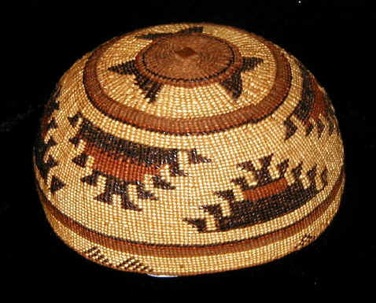
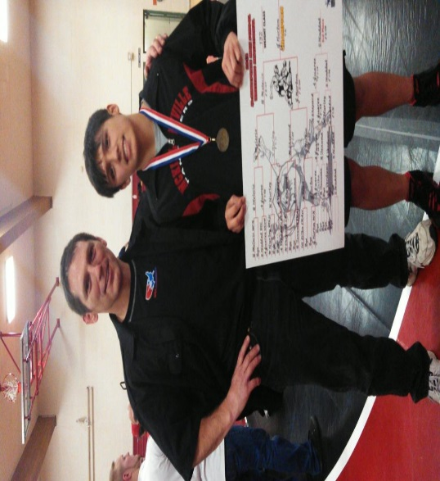
In 2000, the acting Director of the BIA, Kevin Gover (Pawnee), officially apologized for committing genocide against the very people the BIA was charged to serve; the native nations of this land. Therefore, every surviving tribal nation in California must continue to seek justice and equity that may enhance the lives and future of their people for generations to come.
My son and grandson Jack Norton, III and IV.

Slide 29
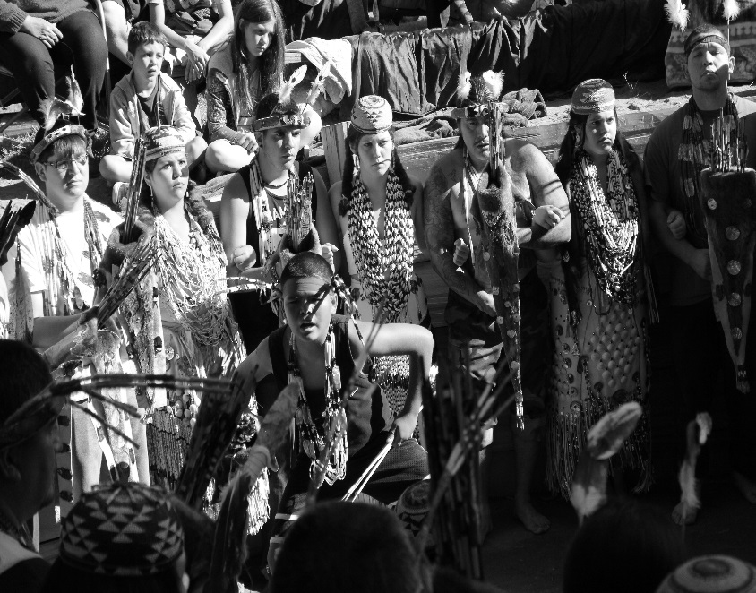
Early morning Brush Dance
The future of California Indian identity is being affirmed through the assertion of tribal sovereignty and traditional life ways and the renewal of ceremonies and rituals.
Every other autumn, the Hupa people still hold their White Deer Skin and Jump Dance ceremonies at Takimildin, the center of their beautiful and secure world. About 60 miles away up the Klamath River the Karuk will dance with prayers for all things near their own center of spiritual purpose and pride. The Karuk recently rejuvenated their Mountain Dance ceremonies in 1994 after 100 years of murder, assault and neglect.

Slide 30
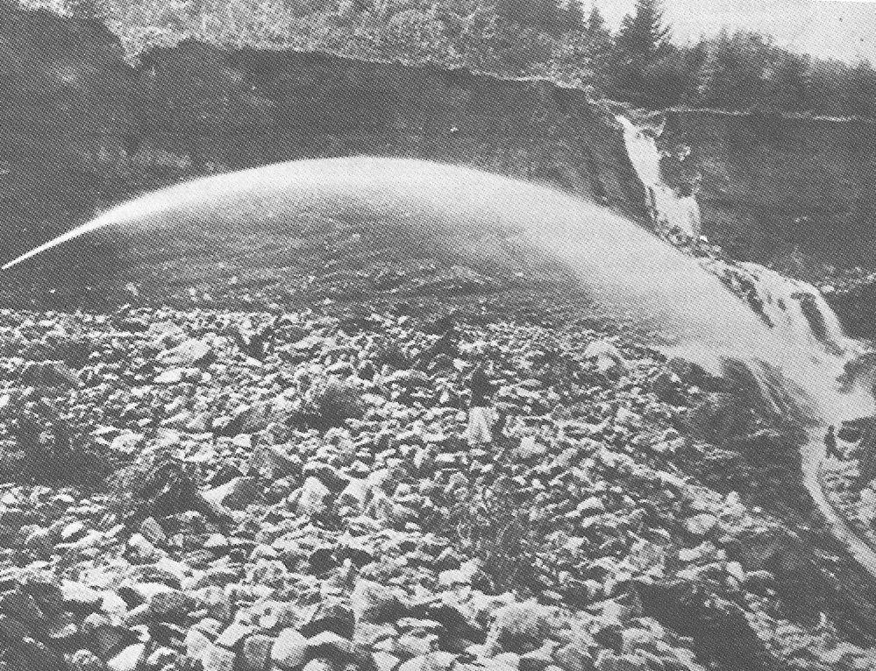
Ironically, or perhaps most poignantly, nearby the traditional dance camps, one can still see the huge iron pipes that once carried water to the hydraulic canons that miners used to wash down the banks of the river to mine for gold. The people still tell of stories where many held their loved one’s bodies as they tumbled from their graves into the river below.

Slide 31
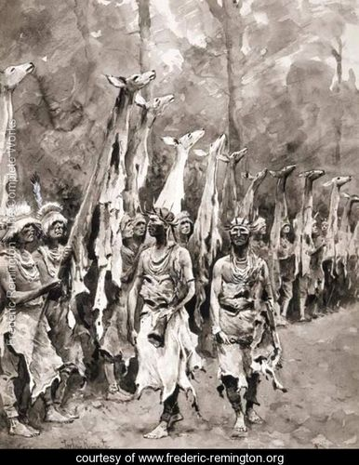
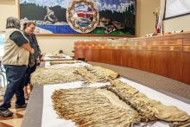
Today . . .
Some religious regalia has been returned to the tribes and the forest service has allowed some access to ceremonial grounds and sacred areas. But the arrogant and paternalistic attitude of the government disallows them the ability to understand the values and beliefs held by most Indian people. Justice Sandra Day O’Connor disregarded the freedom of religion in 1988 to the Yurok, Tolowa and Karuk people by declaring that the US forest service had the right to build a logging road through the heart of the high country that is essential to the spiritual training and preparation for their ceremonies.

Slide 32
However, we will secure our future and our children’s future because we will not forget the strength, bravery, and dedication of our ancestors. We shall not forget the purpose of our ceremonies to honor all life and all things. With the knowledge and commitment of young scholars and leadership of dedicated people, we can strengthen that ideal and live a meaningful life with beauty and dignity on this earth.

Slide 33
References:
Bledsoe, A. J. (1881). History of Del Norte County. Eureka, CA: Humboldt Times
Print - Wyman and Company.
Brandon, W. (1961). The American heritage book of Indians. NY: Dell Publishing
Company.
Castillo, E. D. (1998). The Impact of Euro-American Exploration and Settlement.
In R. F. Heizer (Ed.), Handbook of North American Indians, vol. 8: California
(pp. 99-127). Washington, DC: Smithsonian Institute.
Chalk, F. & Jonassohn, K. (1990). The history and sociology of genocide:
Analyses and case studies. New Haven, CT: Yale University Press.
Dobyns, H. (1976). Native American historical demography. Bloomington, IN:
Indiana University Press.
Goddard, Pliny. “Life and Culture of the Hupa.” University of California
Publication in American Archeology and Ethnology. Vol. 1:1. Berkeley, CA: UCP.
Heizer, R. F. (1974). The destruction of California Indians. Lincoln, NE:
University of Nebraska Press.
Heizer, R. F. & Almquist, A. F. (1971). The other Californians: Prejudice and
discrimination under Spain, Mexico, and the United States. Berkeley, CA:
University of California Press.
Humboldt Times. (December, 1854). Eureka, CA.
Humboldt Times. (May 5, 1855). Eureka, CA.
Humboldt Times. (January 20, 1855). Eureka, CA.
Humboldt Times. (January 27, 1855). Eureka, CA.

Slide 34
Humboldt Times. (February 23, 1861). Eureka, CA.
Humboldt Times. (January 17, 1863). Eureka, CA.
Kroeber, T. (1961). Ishi in two worlds. Berkeley, CA: U of California Press.
McKibben, G. N. (1998). Storyboard Display, Jake Jackson Museum,
Weaverville, CA.
National Archives and Records Administration. Teaching with documents: The
Amistad case. Retrieved March, 3, 2010:
www.archives.gov/education/lessons/amistad
Northern Californian. (March 23, 1859). Arcata, CA.
Norton, J. (1979). Genocide in northwestern California: When our worlds cried.
San Francisco, CA: Indian Historian Press.
Opotow, S. (1990). Moral exclusion and injustice: An introduction. Journal of
Social Issues, 46 (1), 1-20.
Report of the Commissioner of Indian Affairs. (1862). Document 63, p. 315.
Washington, DC: GPO, 1863.
San Francisco Bulletin. (September 13, 1856). San Francisco, CA.
Staub, E. (1992). The roots of evil: The origins of genocide and other group
violence. NY: Cambridge University Press.
Trafzer, C. E. (1999). Exterminate them! East Lansing, MI: Michigan State
University.
Yreka Herald. (August 7, 1853). Yreka, CA.

